Slide 1
Module 5
ERM with Workers Compensation, Insurance, and the use of Frontier Analysis

Slide 2
Chapter 11
Starting from Scratch: The Evolution of ERM at the Workers' Compensation Fund

Slide 3

Notes:
WCF and ERM – pg 207-209
WCF is a mutual insurance company owned by policy holders and governed by a board of 7 members appointed by the governor of Utah
It serves as the carrier of last resort for workers compensation insurance coverage for companies
Great recession of 2007 to 2011 did not materially impact the organization but gave impetus for greater risk assessment throughout the organization and add formality of ERM
Chief Risk Officer
Created in 2010 – Dan Hair – develop and communicate ERM infrastructure within WCF
Direct report to CEO, company executives, and Board Risk Oversight Committee
WCF ERM Risk Management Matrix Values
Incident/exposure probability descriptions
Very low -1 : Improbable
Low – 2 : Remote, may occur once every 10-50 years
Moderate – 3 : Occasional, may occur once every 3 to 10 years
High – 4 : Probable, may occur once every 2-5 years
Very High – 5 : Frequent, could occur annually
Incident/exposure severity description
Slight loss – 1 : Inconsequential with respect to financial, personnel, or board damage: less than 1% of surplus, or $10M loss
Medium loss – 2 : Important financial, personnel, or brand damage, threshold of financial materiality, 5% or more of surplus, or $11M to $25M loss
Material loss – 3 : Material damage to financial strength, personnel, or brand, 10% or more of surplus, or a $51M to 75M loss
Large loss – 4 : Significant damage to financial strength, personnel, or brand; 10% or more of surplus, or a $51M to $75M loss, could damage stakeholder confidence
Very High Loss – 5 : Catastrophic impact on solvency, brand, or personnel; 50% or more of surplus; greater than a $75M loss, would damage stakeholder confidence

Slide 4
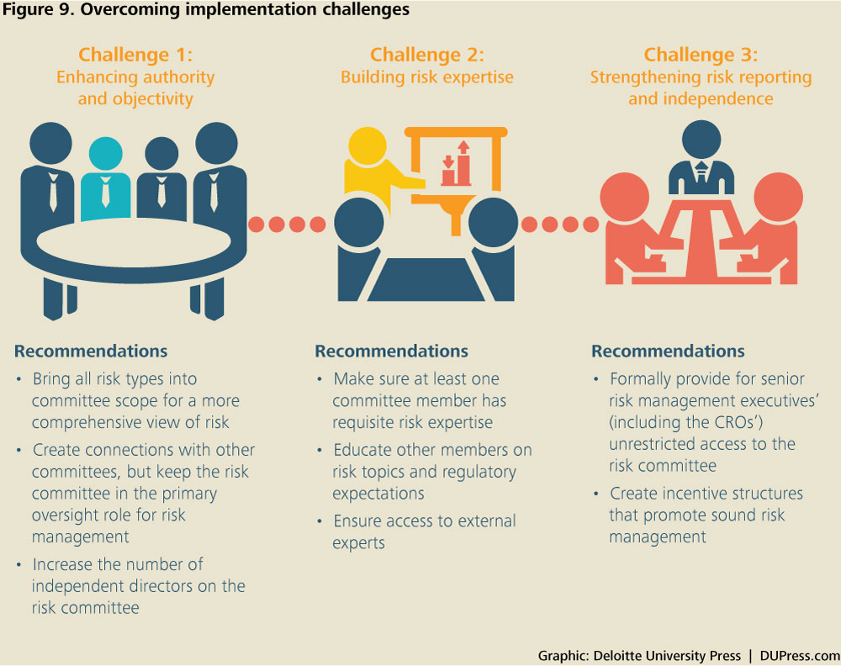
Notes:
Board Risk Oversight Committee – pg 213
Meets 2-3 times per year
Risk champions and representatives of all departments
Reviews reporting and past/future risks
Receives training from CRO and officers
Helps develop WCF risk policies
Risk register (RR) was integrated into the all employee ERM survey – pg 215
Consolidated all information into one excel file
Added new elements necessary to properly manage risk
Fault trees integrated into reporting – pg 219
End point failure diagraming that WCF must avoid
Bottom line of charting displays mitigation requirement buildouts
Risk owner and approvals added to forms – pg 219
Informative as to owner of risk
Assistance in management review and oversight circuit breaker if too much is handled by one person – This happens frequently
Record of risk tasking

Slide 5
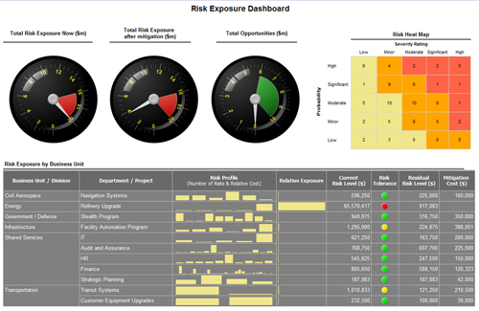
https://www.bing.com/images/search?view=detailV2&ccid=ufyfQoeE&id=0E7B402D824D89F16BB6AE9B26DE0C371F24191A&thid=OIP.ufyfQoeEi_Au94Cb301BGwEsDD&mediaurl=http%3a%2f%2fwww.activerisk.com%2fwp-content%2fuploads%2fRPM-enterprise-preview.jpg&exph=325&expw=500&q=erm+incident+or+exposure+probability+chart&simid=607988472759388060&selectedIndex=0&ajaxhist=0

Slide 6
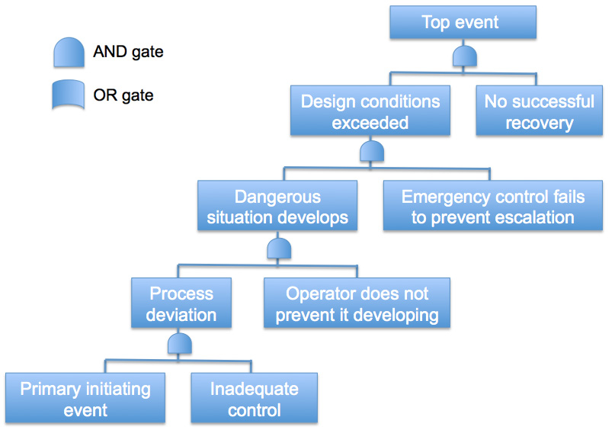
ERM Fault Tree Example
https://www.bing.com/images/search?view=detailV2&ccid=1zAeDSnw&id=57A9C8E0E8E21AFA1B504016FFA1CDFDFC0CE805&thid=OIP.1zAeDSnwFEjg8kegHZ4M3gEsDR&mediaurl=http%3a%2f%2fenalos.com%2fwp-content%2fuploads%2f2014%2f04%2fFault-Tree-Analysis.jpg&exph=564&expw=807&q=erm+fault+trees&simid=608000215225141779&selectedIndex=9&ajaxhist=0

Slide 7
Chapter 14
A Strategic Approach to Enterprise Risk Management at Zurich Insurance Group

Slide 8

Notes:
ERM is both integrated and embedded throughout organization and aligned with strategic, operational planning and budgeting. - pg 253-255
Protect capital base by monitoring that risks are not taken beyond tolerance
Enhance value creation and contribute to an optimal risk/return profile by providing the basis for efficient capital deployment
Support decision-making through timely, accurate, and informative risk information
Protect Zurich brand and reputation through awareness, acceptance, and disciplined risk taking
Core characteristics include a core culture
Committee leadership
Effective governing structure with clear risk responsibilities
Timely escalation procedures, continuous and constructive challenges
Active learning from past mistakes
Reward consideration of risk management objectives an appetite
Line of defense model – page 256
Day to day business decisions – underwriting managing projects, IT solutions, managing human capital issues
Group risk management – Oversees risk identification and governance processes an provides tools and frameworks for decisions
Independent internal audit – Verifies the functionality of the ERM and internal controls framework

Slide 9
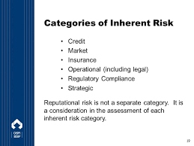
Notes:
External stakeholders involvement in Zurich risk management – pg 261
Rating agencies play a key role – rating companies creditworthiness
International industry organizations – Advancing ERM dialogue to combat risk at client level
Main contributor to Global Risk Management Report – World Economic Forum
Zurich proprietary toolkit for ERM – pg 263-266
Total risk profiling – client workshop facilitator based approach to client risks
Hazard analysis – Systematically identify, address, and manage various types of hazards or vulnerabilities and managing corresponding risks
Risk room – Explore major global risks and expressed within a country by country basis
Zurich categorization of risks – pg 267-268
Strategic risks – Unintended risks as a by-product of planning and executing strategy
Insurance risks – Uncertainty regarding the occurrence, amount, and timing of insurance liabilities
Market risks – A group’s balance sheet positions where the value or cash flow depends on financial markets
Credit risks – loss or potential loss from counterparties failing to fulfill their financial obligations
Liquidity risks – Zurich risk that it may not have enough liquidity to meet obligations if they fail
Operational risks – Zurich’s people. processes, systems, and external events
Reputational risks – Risks from an act or omission that could result in damage to the Zurich reputation or loss of trust amount stakeholders (internal and external)

Slide 10
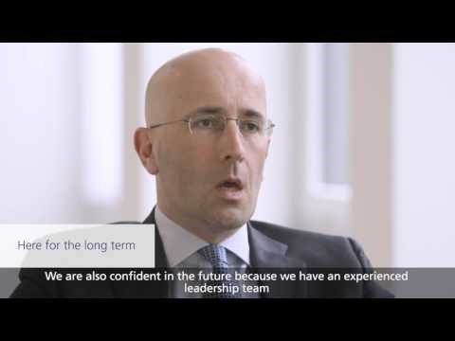
Zurich Insurance
https://www.bing.com/videos/search?q=ERM+in+zurich+insurance&&view=detail&mid=052974974045FE9CA860052974974045FE9CA860&FORM=VRDGAR

Slide 11
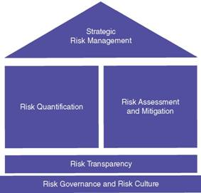
Zurich Risk Management Framework
https://www.bing.com/images/search?view=detailV2&ccid=6xgTCTd%2f&id=F850AD4FF426672AE6F28FFCA232EC61943D61BA&thid=OIP.6xgTCTd_knx0suiNZtkivgEbEP&mediaurl=https%3a%2f%2facademlib.com%2fimag%2fmanag%2ffras_imperm%2fimage058.jpg&exph=271&expw=283&q=zurich+risk+management+framework&simid=608053962408200449&selectedIndex=0&ajaxhist=0

Slide 12
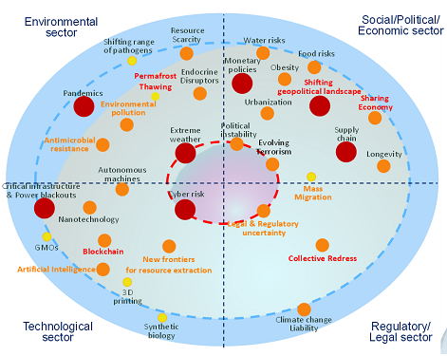
Example of a Risk Radar Mapping Used within Zurich’s Toolkit
http://www.agcs.allianz.com/assets/ContentImages471x160/White%20Papers%20and%20Case%20Studies/CROForumRiskRadarOct2016_471.png

Slide 13
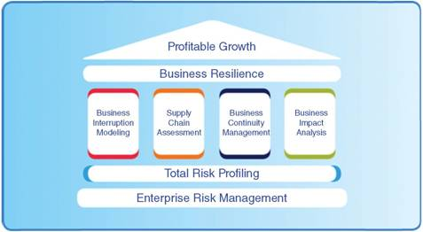
Zurich’s Business Resilience Program
http://academlib.com/imag/manag/fras_imperm/image066.jpg

Slide 14
Chapter 25
Uses of Efficient Frontier Analysis in Strategic Risk Management: A Technical Examination

Slide 15
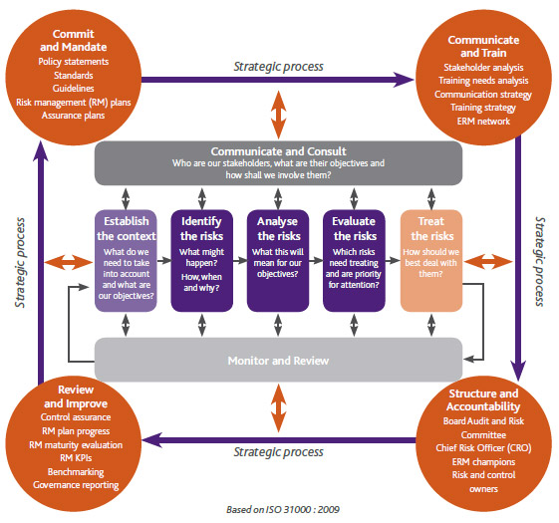
Strategic Risk Management Diagram
https://www.bing.com/images/search?view=detailV2&ccid=zZvb969R&id=DADE12BC5E6B6D1349A647323311CCF4DAF6DA84&thid=OIP.zZvb969R6JOZ36TvKweWygECDx&mediaurl=http%3a%2f%2fwww.overendstudio.co.za%2fwebsites%2fpetmin%2fimages%2frisk_management_2013.jpg&exph=525&expw=561&q=strategic+risk+managmenet+diagram&simid=608027479644638311&selectedIndex=0&ajaxhist=0

Slide 16
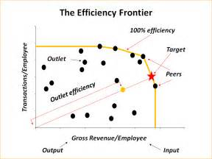
Zurich’s Business Resilience Program
https://www.bing.com/images/search?view=detailV2&ccid=oNcRFef5&id=BA7F7B4EEF777A8C6AFB2CC4374198FF6EEE5285&thid=OIP.oNcRFef5128mOPYQEdw-GQEgDY&mediaurl=http%3a%2f%2fwww.prismdecision.com%2fwp-content%2fuploads%2f2010%2f01%2fEfficiency-Frontier.png&exph=720&expw=960&q=efficient+frontier+analysis+diagram&simid=608046626611593614&selectedIndex=0&ajaxhist=0

Slide 17
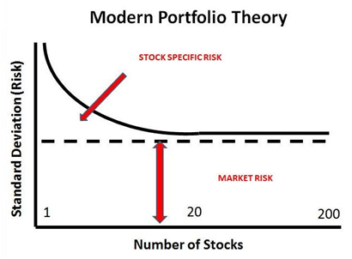
https://www.bing.com/images/search?view=detailV2&ccid=LexpFX2G&id=7E82726F82D2121B77199528CD8BEAEB15FC78B8&thid=OIP.LexpFX2Gz7Gr-ttdncCzvQEjDW&mediaurl=http%3a%2f%2fholbornassets.com%2fwp-content%2fuploads%2fModern-Portfolio-Theory.png&exph=302&expw=410&q=modern+portfolio+theory+outcome+chart&simid=607986321007641318&selectedIndex=1&ajaxhist=0

Slide 18
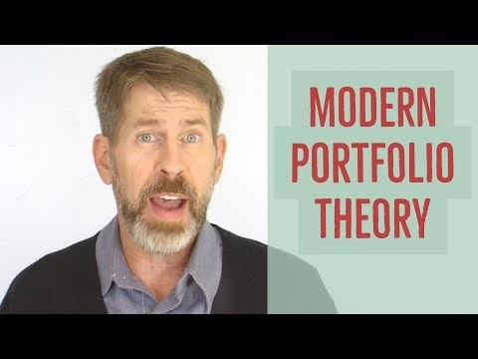
Modern Portfolio Theory
https://www.bing.com/videos/search?q=modern+portfolio+theory+outcome+chart&&view=detail&mid=27DBAB9936ADA44F413527DBAB9936ADA44F4135&FORM=VRDGAR

Slide 19
References
John R.S. Fraser, B. J. (2015). Implementing Enterprise Risk Management. New Jersey: Wiley & Son, Inc.,

